Slide 1

VISUAL ANALYTICS
An Interactive Visual Analytics Dashboard for Exploring Spotify's 2023 Top-Streamed Songs
Decoding Musical Intelligence Through Audio Features
Carlos Fernández Fernández
Alberto Rivas Casal
Engineering in Computer Science - Sapienza

Slide 2
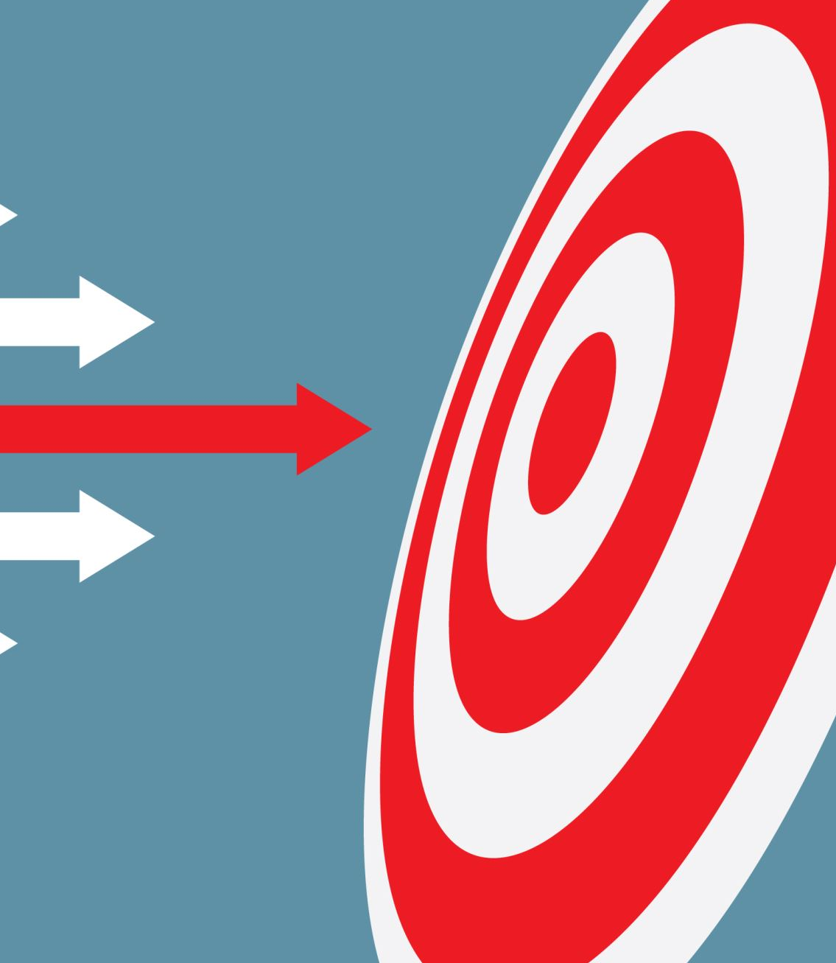
GOAL and introduction
Introduction
2. Intended users:
- A&R profesionals and Data Analyst
3. Core Design Decisions

Slide 3
Why a Dashboard for Music Analysis?
The Challenge:
100M+ tracks on Spotify with rich audio features (energy, danceability, valence, etc.)
Streaming success is complex — not obvious what makes songs popular
Data exists, but exploring patterns requires technical skills (SQL, Python, etc.)
The Opportunity:
Visual interfaces reveal patterns humans can't see in spreadsheets
Interactive exploration lets users ask "what if?" questions in real-time
Clustering similar songs helps A&R professionals discover trends
Our Solution:
t-SNE reduces 8 audio features → 2D space (clusters emerge naturally)
Lasso selection + coordinated views = explore without writing code
Real Spotify 2023 data = relevant, real-world insights

Slide 4
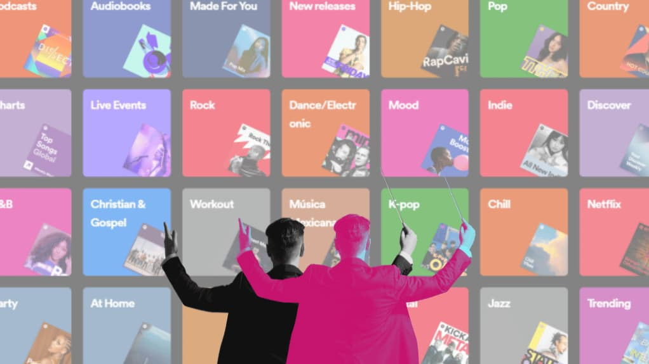
Who is this for
Primary Users
Music Data Analysts — explore acoustic patterns across genres/artists
A&R Professionals — identify clusters of similar successful tracks for talent scouting
Playlist Curators — find songs with specific audio profiles (high energy + high danceability)

Slide 5

Who is this for
Secondary Users
Music Journalists — visual storytelling about trends ("2023 was the year of low-valence pop")
Academic Researchers — study relationships between audio features and streaming success
Curious Listeners — self-directed exploration ("what do my favorite songs have in common?")

Slide 6
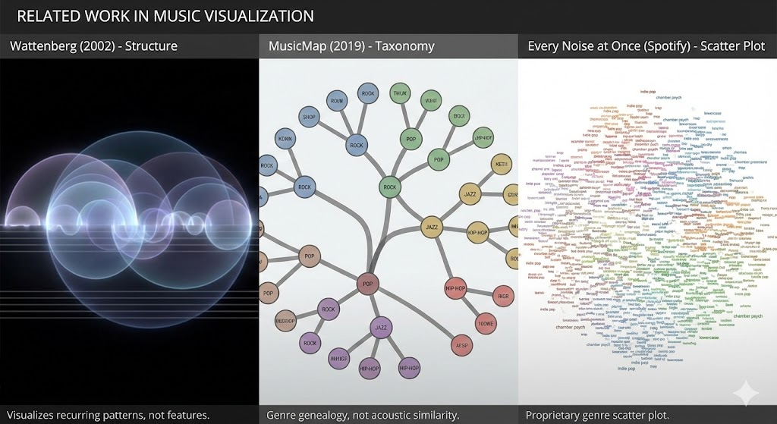
Related work (Music Visualization)
The Shape of Song (Wattenberg, 2002) — visualized musical structure, but not audio features
MusicMap (2019) — genre-based 2D layout, but focused on taxonomy not acoustic similarity
Every Noise at Once (Spotify) — scatter plot of genres, proprietary system
Our contribution: Open, reproducible, feature-driven (not genre labels)

Slide 7
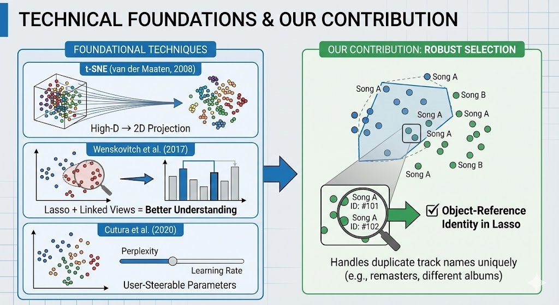
Related work (Dimensionality Reduction + Interaction:)
t-SNE (van der Maaten, 2008) — standard technique for high-D → 2D
Wenskovitch et al. (2017) — proved lasso + linked views improve understanding of DR projections
Cutura et al. (2020) — user-steerable t-SNE parameters
Our contribution: Object-reference identity in lasso (handles duplicate track names)

Slide 8
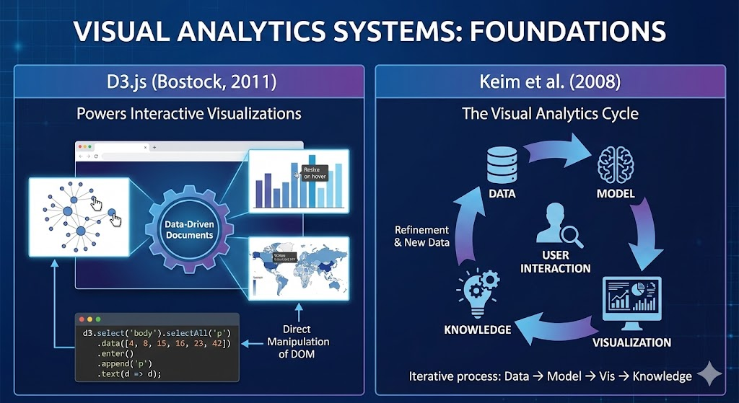
Related work (Visual analytic systems)
D3.js (Bostock, 2011) — powers our interactive visualizations
Keim et al. (2008) — defined the VA cycle we follow (data → model → vis → knowledge)
Our contribution: Full implementation of VA cycle for music data with Spotify API features

Slide 9
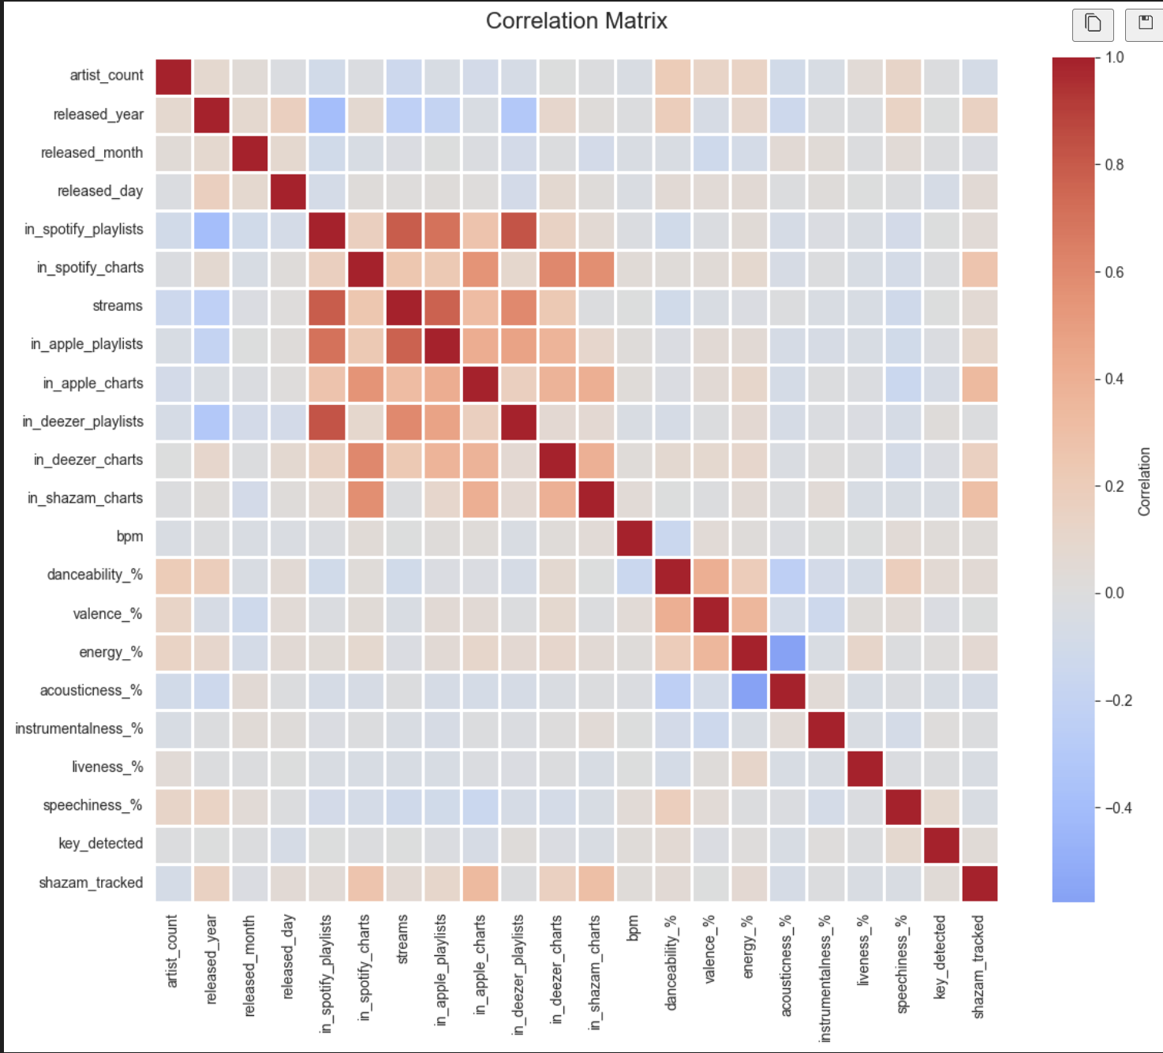
The Dataset
Dataset Description
Data Issues and Cleaning:
Type Coercion
Missing Values
Outlier Analysis
Normalization
Correlation matrix plot of the data

Slide 10
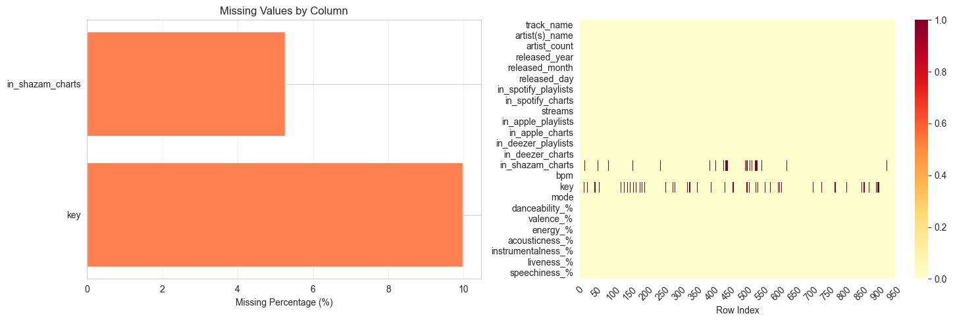
Data cleaning
Initial Data Inspection
Problems Founded
Handling Outliers/Missing Values

Slide 11
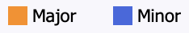
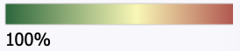
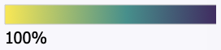
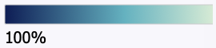
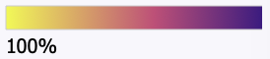
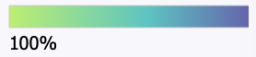
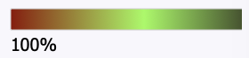
Color Selection
Mode (Major vs. Minor)
- Color Hue
Valence (Happiness):
Energy:
Acousticness:
Danceability:
Speechiness
Liveness: Blue/Green/Read.

Slide 12
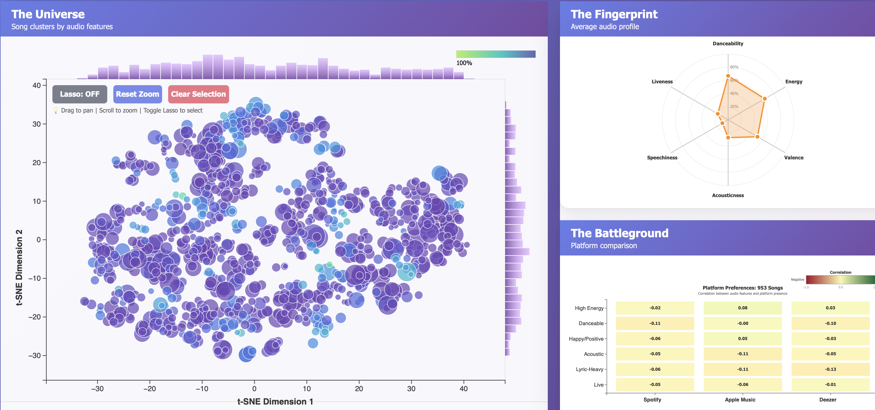
Scales
The Size
Axes Scales
The Universe
The Fingerprint
Radar Chart and Normalization
Interaction Scales (Zoom&Pan)

Slide 13
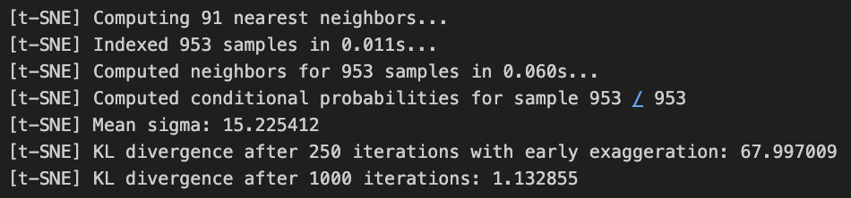
Dimensionality Reduction
Feature Selecction
Danceability, Energy, Valence, Acoustiness, speechness, liveness, instrumentalness.
t_SNE
Why t-SNE?
Integration into the Analysis Flow

Slide 14
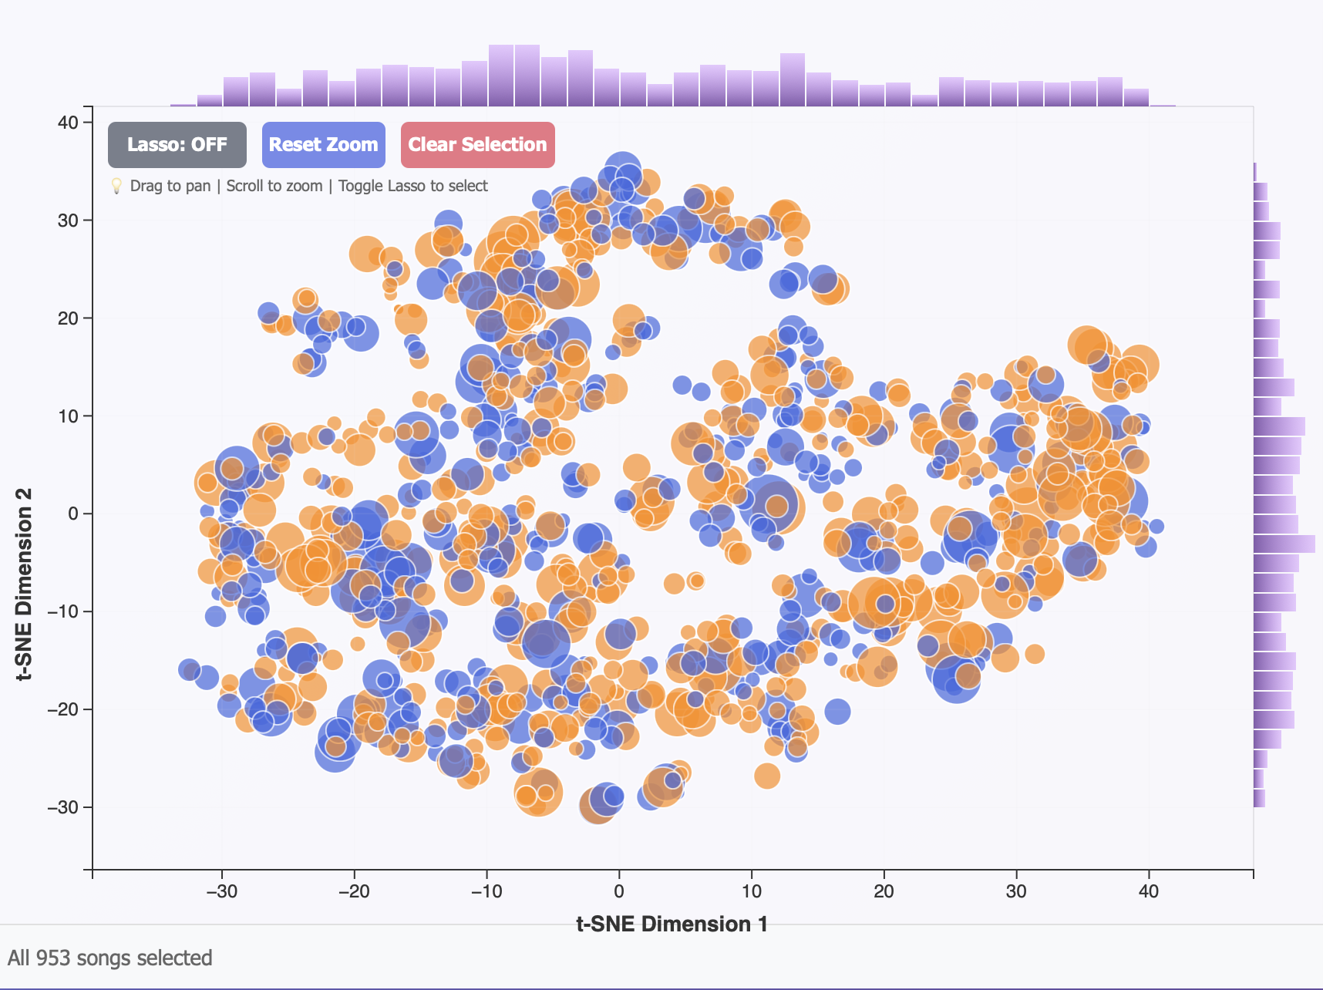
The Universe
Maping songs into a two dimentional space based on their acoustic
Position: t-SNE projected dimensions.
X: t-SNE Dimension 1
Y: t-SNE Dimension 2
Size: Popularity (Total Streams).
Color Selection:
Radius
Opacity

Slide 15
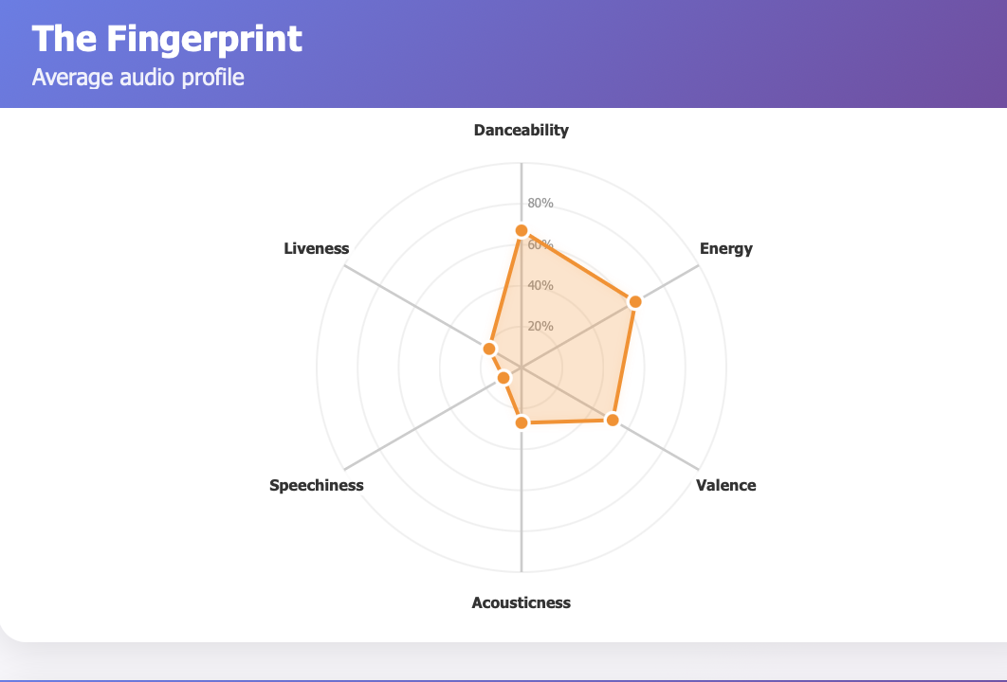
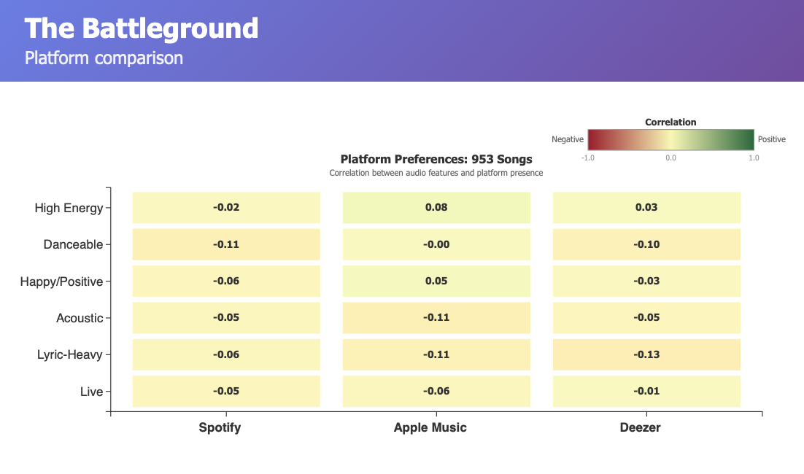
Coordinated Views
The Fingerprint:
Allows users to see if a cluster is characterized by high Energy, high Acousticness, Valence...
The Battleground:
Compares performance across Spotify, Apple Music, and Deezer for the active selection.

Slide 16
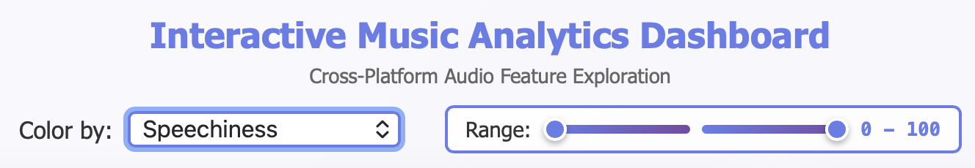
Filter SELECTION
Mode Filter
Artist Search
Range Slider
Badge Counter
Clear All

Slide 17
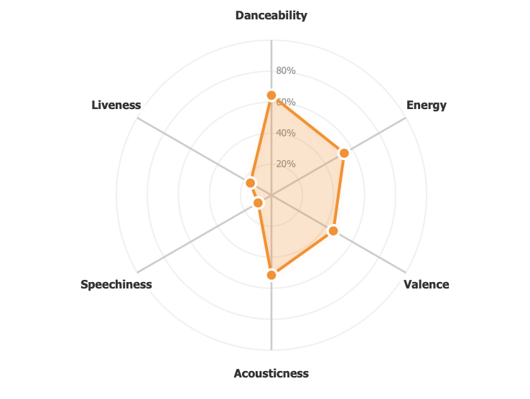
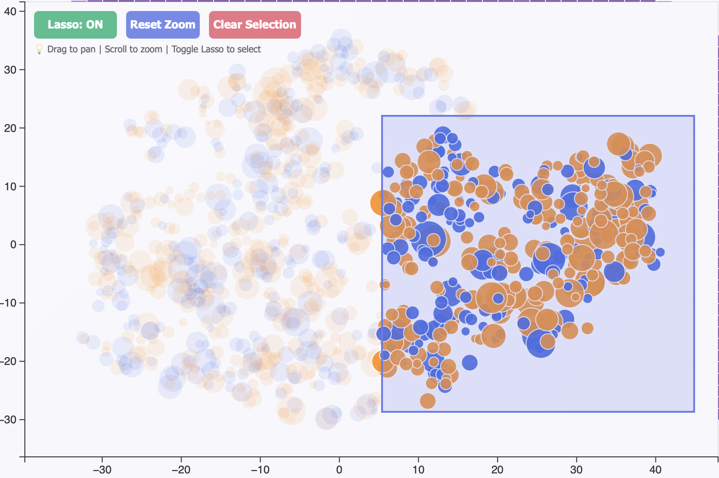
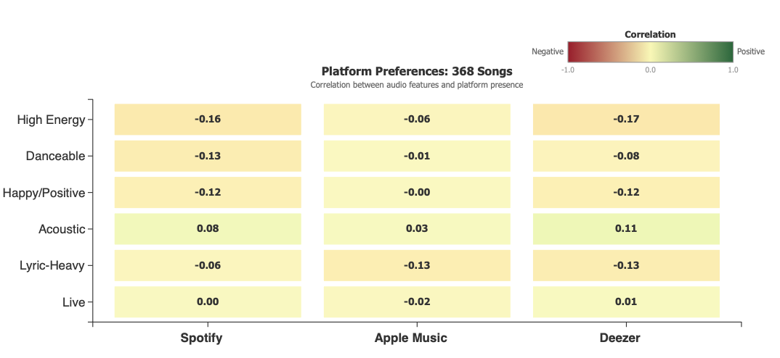
The Lasso Tool
Ghosting Effect: Non-selected songs are faded
Mechanism: When a user selects a group
The average audio profile in the Radar Chart.
Correllation between audio features in Battlegorund

Slide 18

Discovered Insights
"STUDIO POLISH"
"SYNTHETIC-ORGANIC TRADE OFF"
"SOME OBSERVATIONS"

Slide 19
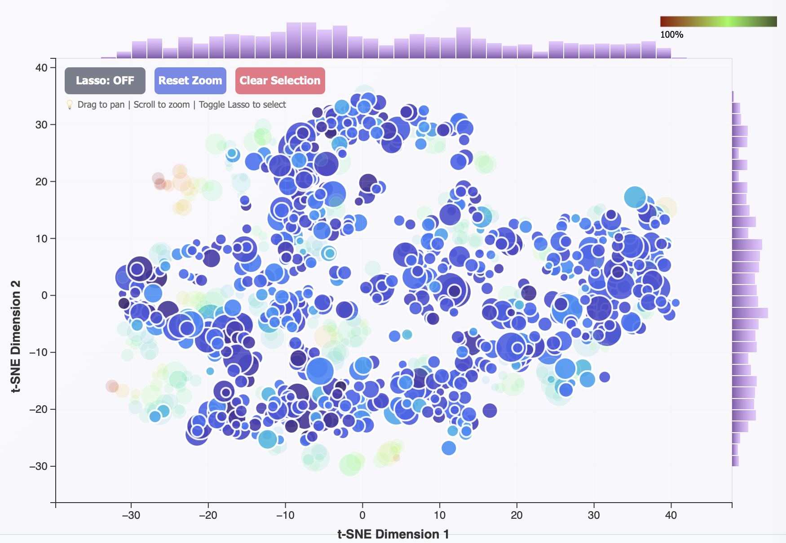
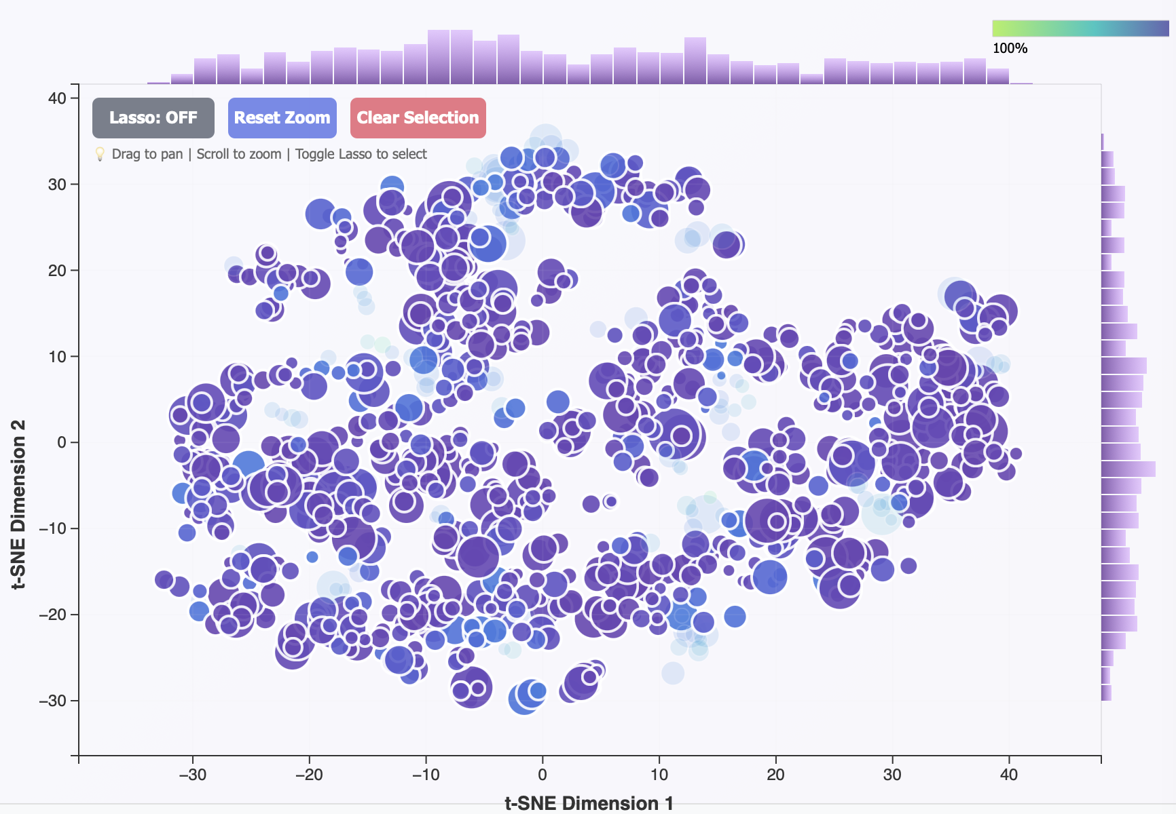
Studio Polish
Low Liveness + Low Speechiness
Insight:
The 2023 Top Charts are dominated by technical perfection.
Conclusion for the analyst

Slide 20
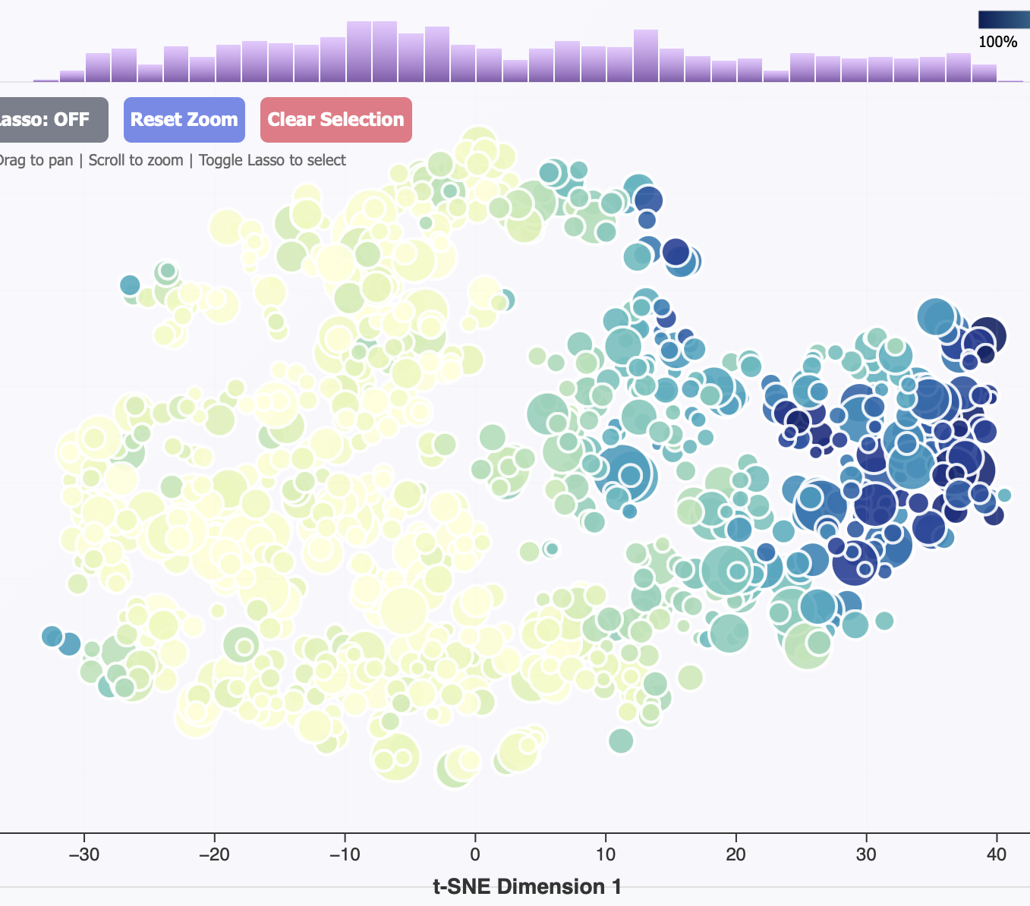
Synthetic-organic trade off
Acousticness divided
Insight:
A clear polarization in instrumentation.
Conclusion for the analyst

Slide 21
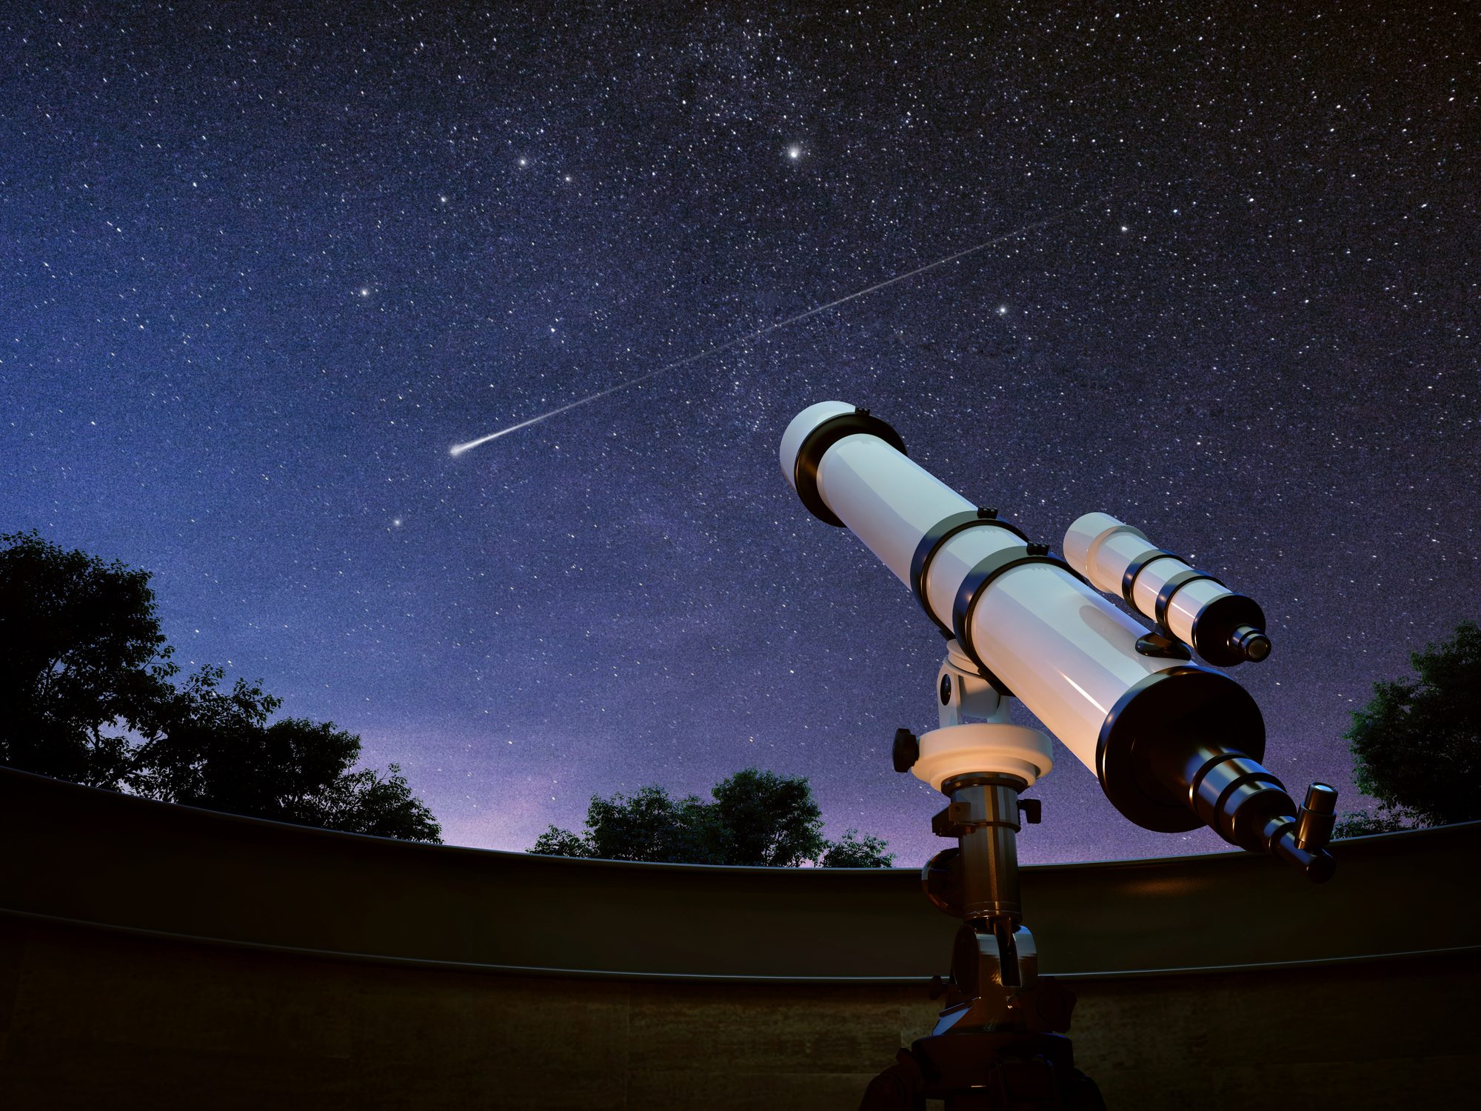
Some observations
Mode-Based Clustering: Beyond Tonality
Distribution of High-Stream Songs

Slide 22
Conclusion
SpotifyVA Overview
Academic Compliance
Future Work

